Slide 1








SharkTrack
Johana
Tiago
Konstantin
Jean Philippe
SHARKTRACK
PITCH DECK
Use the power of Data to study Shark behaviour and attack to prevent unnecessary future attacks.
210
262
Locations
Fatal Attacks

Slide 2


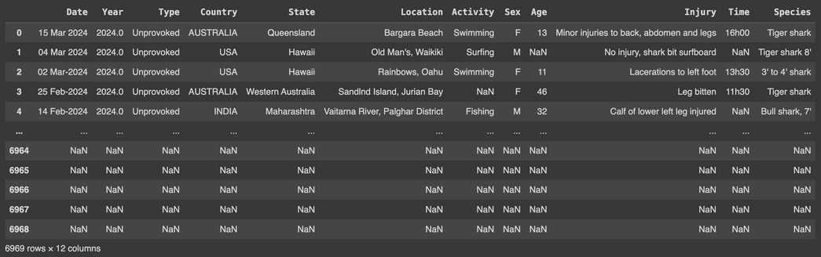
SharkTrack
Johana
Tiago
Konstantin
Jean Philippe
BUSINESS PROBLEM
67
INTRODUCTION ON PROBLEM
Countries
200
Public awareness about shark attacks is often limited, leading to inadequate preparation and heightened risk. Additionally, current data on shark attacks is fragmented, making it challenging to identify patterns and hotspots effectively.
Years
WE DOVE INTO THE DATA
WE DOVE INTO THE DATA
1.7K
TO HELP YOU
Reported Attacks
TO HELP YOU

Slide 3



SharkTrack
Johana
Tiago
Konstantin
Jean Philippe
Business Opportunity
By consolidating and analyzing shark attack data, SharkTrack can offer valuable insights into the frequency, location, and circumstances of shark attacks. This information can be used to develop more effective safety protocols, allocate resources more efficiently, and potentially create educational materials or alerts to inform the public, thereby reducing the risk of shark attacks. This information can also help:
Enhance Public Safety
Improve Emergency Response
Support Research
To provide real-time data on shark attack risks
To allocate resources and implement preventive measures
To to study shark behavior and develop strategies

Slide 4



SharkTrack
Johana
Tiago
Konstantin
Jean Philippe
Our Initial Hypotheses
Hypothesis 1: Predictive Patterns in Historical Data
Hypothesis 2: Geographic Hotspots
Hypothesis 3: Seasonal Influence
Historical shark attack data contains identifiable patterns related to time of year, location, and human activities, which can be used to predict and reduce the future risks.
Certain geographic areas are more prone to shark attacks due to environmental factors such as water temperature, proximity to feeding grounds, or human activity levels.
Shark attack frequency is influenced by seasonal variations, with certain times of the year/day posing higher risks due to migratory patterns or breeding seasons.
Analyze the temporal data in the shark attack dataset to identify seasonal trends. For planning and implementing seasonal safety campaigns or temporary restrictions in high-risk periods.
Use Pandas to analyse historical data for trends, such specific activities, and assess the potential for these patterns to predict future shark encounters.
Map and analyze attack locations. This analysis could inform targeted safety measures and resource allocation.

Slide 5

SharkTrack
Johana
Tiago
Konstantin
Jean Philippe
Data Wrangling & Cleaning
Challenge
Team Discussions & Brainstorming
Huge part of the data was missing, incomplete or badly formatted, probably because the reports don't share the format between countries, we had to read the data as we were cleaning to make sure we could use it.
Date types are a bit confusing to understand and Regex is not easy to use, as the formatting can be complex.
01
Break work into smaller steps
02
03
Use of AI for guidance
04
Daily planning and separation of tasks

Slide 6
SharkTrack
Johana
Tiago
Konstantin
Jean Philippe
Exploratory Data Analysis
Challenge
Working with new tools, that we need to master before being able to produce the results and visual data we needed.
Connecting the Data Frames to the Data Analysis libraries (Matplotlib, Seaborn, Ploty), is time consuming to learn how to input correctly the data on this libraries
01
Trying different data connections
02
Avoid overthinking in results
03
Explore new libraries
04
Missing data from lacking of format

Slide 7
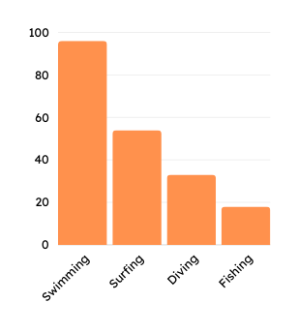
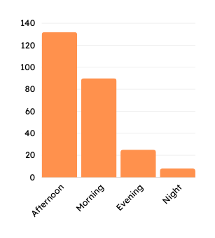
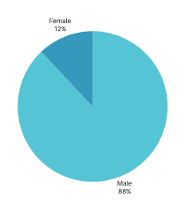
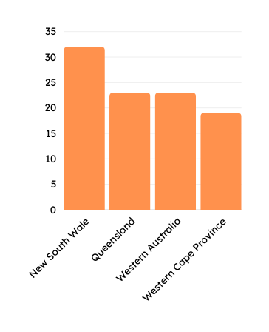
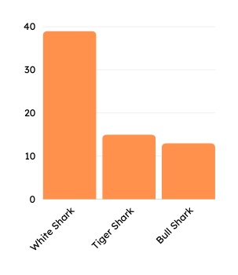
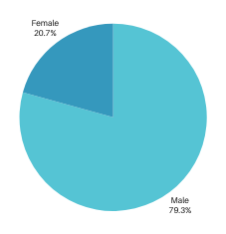
SharkTrack
Johana
Tiago
Konstantin
Jean Philippe
WHO IS MORE AT RISK?
WHICH ACTIVITY IS RISKIER
WHEN IS IT MORE LIKELY?
LOCATION WITH A HIGHER RISK?
WHO DIE MORE?
WHAT SPECIES KILLS MORE?

Slide 8

SharkTrack
Johana
Tiago
Konstantin
Jean Philippe
MORE LIKELY
MORE LIKELY
MORE LIKELY
88%
48%
52%
Male
Swimming
of attacks happen in the Afternoon
MORE LIKELY
MORE LIKELY
MORE LIKELY
33%
21%
58%
New South Wale Australia
Fatal
White Shark

Slide 9

SharkTrack
Johana
Tiago
Konstantin
Jean Philippe
Major obstacle
We learnt
Unrealistic Deadlines
A good organisation with distribution of tasks and established a transparent communication allowed us to move forward.
We also learnt to rely on each other more and work together more effectively, which made this mini project a better learning experience for everyone.

Slide 10
SharkTrack
Johana
Tiago
Konstantin
Jean Philippe
Insights and Implication
Surprising Insights:
Unexpected: Gender disparity
This stark gender disparity raises several questions and potential areas for further investigation.
Activity Correlation : While surfing was a known risk factor, our analysis discovered that swimming activity is impacted the most and strongly correlated with attack rates, which could influence public safety recommendations.
Potential implication :
The insights can refine the "Shark Track" tool to provide more accurate warnings, enhance public awareness of high-risk areas and activities, and help authorities allocate resources more effectively, such as by increasing patrols or launching educational campaigns.
On the future, additional analysis could focus on deeper factors influencing attack patterns, such water temperature or local marine life behaviours

Slide 11
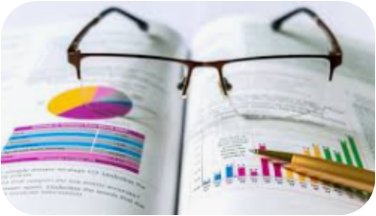
SharkTrack
Johana
Tiago
Konstantin
Jean Philippe
Conclusion
We hypothesised that analysing shark attack data could reveal patterns related to geographical locations, time of day, and activities that increase the risk of shark attacks.
We believed this information could be used to develop a business case for "Shark Track," a tool to help users avoid high-risk areas and time.
SUPPORTED OUTCOME
Our analysis generally supported the hypothesis. We found significant patterns indicating that certain locations and times of year have a higher incidence of shark attacks. For instance, attacks were more frequent in specific regions and during certain months.

Slide 12

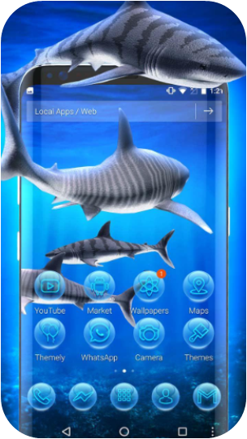
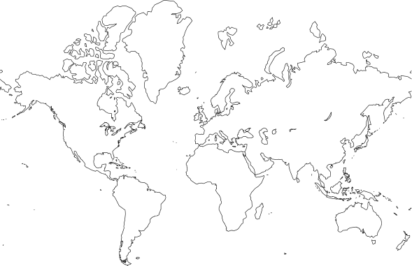

SharkTrack
Johana
Tiago
Konstantin
Jean Philippe
SharkTrack
The app that provides real-time alerts to users about nearby shark sightings, using advanced data analytics to identify predictive patterns, geographic hotspots, and seasonal trends, while offering an intuitive interface and educational resources to enhance safety and awareness for marine sport enthusiasts, researchers, and local authorities.

Slide 13
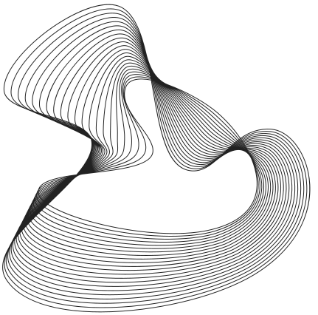

SharkTrack
Johana
Tiago
Konstantin
Jean Philippe
WEEK 2 PROJECT
DATA WRANGLING & RETRIEVAL
THANK YOU
Johana
Tiago
Konstantin
Jean Philippe
Data Analyst
Data Analyst
Data Analyst
Data Analyst

